Slide 1


SAP BTP Training
Cloud Foundry Training

Slide 2

DISCLAIMER
The training content and delivery of this presentation is confidential, and cannot be recorded, or copied and distributed to any third party, without the written consent of Anubhav Trainings

Slide 3

LEARNING OBJECTIVES
Working with Postgre in BTP
Create backing service in BTP
Implementation steps
Integrate postgre and deploy to CF
OData with Olingo
Introduction to Olingo framework
Build application using olingo
Integrate fiori app
Working with Jenkins

Slide 4
Backing Service in CF
A backing service in CF is just a reusable service. We will use these backing service for different purpose
DB as a service – PosgreSQL, SAP HANA, SAP HANA HDI, Mongo, Redis
Queue – Rabbit MQ, Kafka
Authentication manager – UAA service
Connectivity Service
Our application will bind to these services and use them out-of-box. As a app developer we don’t have to worry about running most of these functionalities own our own.
Steps:
Start a new backing service instance
In order to access these backing service we need add a services entry in our app’s manifest.yml file
The cloud foundry also provides Environment variables, which we can use to connect to these backing service. This way its fully flexible. To check these environment variables we can use command cf env <appname>
Advantage:
Never need to hardcode our db credentials anywhere, the app will look for it and connects to it
Scale backing service individual
Complete management of backing service using CF cockpit or command line
Take care of auto binding in D, Q and Production
www.anubhavtrainings.com

Slide 5
Steps
Create a new instance of backing service – Postgre
Create and add an entry for that backing service in our manifest.yml
Delete the properties file which has hardcoding of DB connection
Add new dependencies in our project
Spring-cloud-cloudfoundry-connector
Spring-cloud-spring-service-connector
Ngdbc – DB Driver
Dbcp2
Org.eclipse.persistence.jpa
Implement 2 classes
Database Config class as described above, This class will use the variables to create a new data source connection. This data source connection will be passed to Spring JPA. Spring JPA needs EntityManager (Create, Alter DB Tables) and Transaction Manager(To CRUD). This class has 3 methods
Create a DB Connection
Create EntityManager by using our own DB Connection
Create Transaction Manager by using our own connection
Entity Manager class which will have all the settings and address of our entity classes.
We can change settings if we want into the EntityManager Factory.
Build project – skip test
Looking in CF environment a variable with name VCAP_SERVICES and parse it. Pass this information to a configuration class which we will register with spring. The class must inherit AbstractCloudConfig
Pool the connections and control the flow of calls to avoid flood to DB. Good for performance.
EclipseLink is a JPA implementation, which is responsible for creating EM, TR
www.anubhavtrainings.com

Slide 6
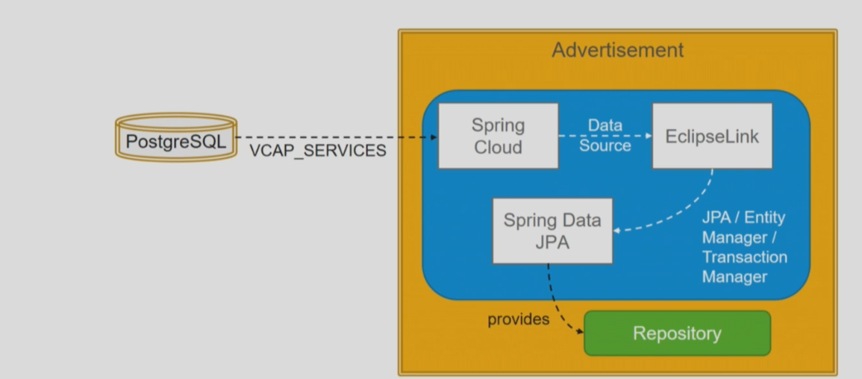
Access Environment Va riable - Postgre
www.anubhavtrainings.com

Slide 7
Integrate with Postgre SQL
Based on the above-mentioned information, We can refer below source code to integrate postgre database in SAP BTP cloud foundry environment.
www.anubhavtrainings.com

Slide 8

Cloud Development Char.
Faster Innovations
Lower TCO
Value to time
Scalability
DEVOPS
CD – Continuous Delivery
Jenkins
Git
maven
CF
gitHUB
Maven Build
CF CLI
cf push
CF
push
war
www.anubhavtrainings.com

Slide 9
OData Service on CF
Olingo is a framework provided by Apache as open source for building OData Services using Java. Fiori Applications can directly work with OData effectively.
https://www.youtube.com/watch?v=zERJjFd3Lxo
ODataServelt
ODataServiceFactory
MyODataAnnotation
@WebServelt
OData Servelt
URL Pattern
/anubhav.svc
MyODataServiceFactory
MyODataProcessor
MyODataSource
Client
ODataInterface
VendorODataAgent
AddressODataAgent
www.anubhavtrainings.com
Notes:
[standard] Odata Servlet – it is an entry point for odata calls. Similar to the service name in ABAP which we register in /n/IWFND/MAINT_SERVICE
[standard] Odata Service Factory – Provide object of other classes (3 more classes)
[standard] Odata annotations – provide odata annotations, like in ABAP sap:creatable, sap:updatable, sap:nullable
[standard] Odata Processor – Handle HTTP Request and Response, GET, PUT, POST, DELETE, Media Resource – CL_HTTP_HANADLER standard SAP Class
[standard] Odata Source – Provide the entity and entity sets – define skeleton of the data and serve definition
ODataInterface – provided by framework to register our entities

Slide 10
Steps
We need dependencies to get Olingo imported (pom.xml)
Olingo framework
Olingo-jpa
Servelet
Servelt Class, Tell our spring app to scan the servelet class in package
Add all the Olingo implementing classes ODataFactory, ODataAnno, ODataProcessor, ODataSource, ODataInterface
Add Annotations to our Entities to offer as EntityType and EntitySet
Add ODataAgent (DPC_EXT) Which will have implementation for CRUDQ
Additionally we can add Fiori UX
www.anubhavtrainings.com

Slide 11
Steps
Steps
Download and install Jenkins https://www.jenkins.io/download/
Set JAVA_HOME, M2, M2_HOME, JENKINS_HOME Environment Variables
It will run automatically as a window service on port 8090 - http://localhost:8090/
Default user and password is admin / admin
Go to manage Jenkins → Manage Plugins
Maven Integration plugin
GitHub
Cloud Foundry Plugin
www.anubhavtrainings.com

Slide 12

Summarize
LET’S SUMMARISE!

Slide 13

Summarize
End of Day 6

Slide 15


We’re committed to empower you to be
#FutureReady
through powerful training solutions.
We build the workforce of the future.
250+
Corporate Clients
30,000+
Learners Trained
25000+
Learners Placed
FREE WEBINARS
Sign up for free webinars with industry experts every fortnight!
Enroll Now!
Contact us today!
https://anubhavtrainings.com

